Slide 1

Notes:
(Introductory graphics)
(Remember to click the “Keypoint” tab at the top of the screen, then the “Click to enable” button at the upper-left)
(To clear previous responses, on a Question slide, from the Keypoint tab, select “View Responses”, then “Clear Responses” or “Clear All Responses”)

Slide 2
Global Grants
How Your Contributions Are Creating Hope in the World
Notes:
In addition to the District Grants we talked about earlier, The Rotary Foundation funds larger project as Global Grants

Slide 3
Global Grants – Budget Size
What is the lowest budget for a Global Grant?
$10,000
$30,000
$100,000
$1,000,000
Why don’t you just tell me?
15
Notes:
(POLL: How much does a project have to cost to get a Global Grant?)
Answer: $30,000 or more

Slide 4
Global Grants – Budget Size
0% Sample Choice
Notes:
(POLL: How much does a project have to cost to get a Global Grant?)
Answer: $30,000 or more

Slide 5
Global Grants – Areas of Focus
Which is NOT one of Rotary’s seven Areas of Focus?
Water, Sanitation and Hygiene
Basic Education and Literacy
Environment
Full Employment
Peacebuilding and Conflict Resolution
Disease Prevention and Treatment
Maternal and Child Health
15
Notes:
(POLL: Which is NOT one of Rotary’s Seven Areas of Focus is missing?)

Slide 6
Which is NOT one of Rotary’s seven Areas of Focus?
Notes:
ANSWER: Full Employment

Slide 7

Rotary’s Seven Areas of Focus
Notes:
All Global Grants Fall Into One of these Seven Areas of Focus
Peace & Conflict Resolution
Disease Prevention & Treatment
Water, Sanitation & Hygiene
Maternal & Child Health
Basic Education & Literacy
Community Economic Development
Environment
Funding is concentrated in these areas to give us a greater return on our investment

Slide 8
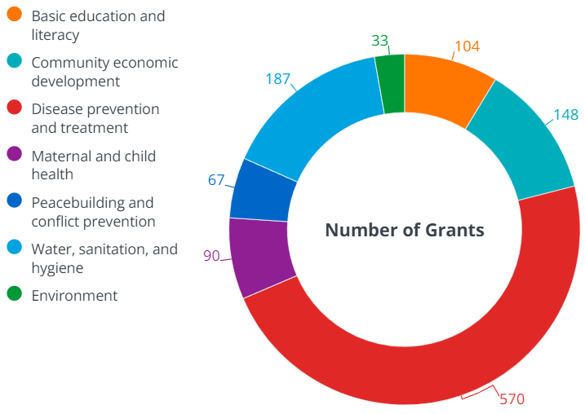
Number of Global Grants in a Year (2021-22 Rotary Year)
Notes:
This gives you an idea of which of these seven areas of focus are receiving the most funding
The need for Disease prevention and treatment projects far outweigh the other six areas and has for several years

Slide 9
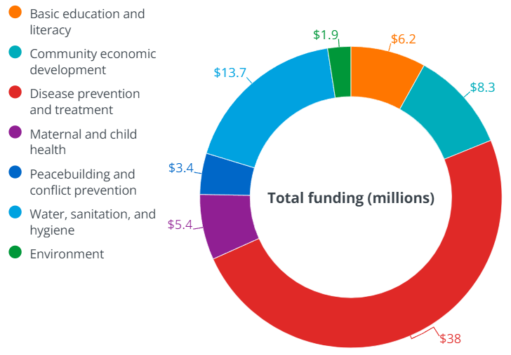
Global Grant Dollars Expended in a Year (2021-22 Rotary Year)
Notes:
This is the same breakdown, but by millions of dollars in grants in each area
Altogether, over $14.5 million in our donations funding engaged local clubs and districts to create hope in the world

Slide 10
Recent Global Grants
Notes:
These are some of the Global Grants in which our District is engaged, and which your donations helped make possible.

Slide 11
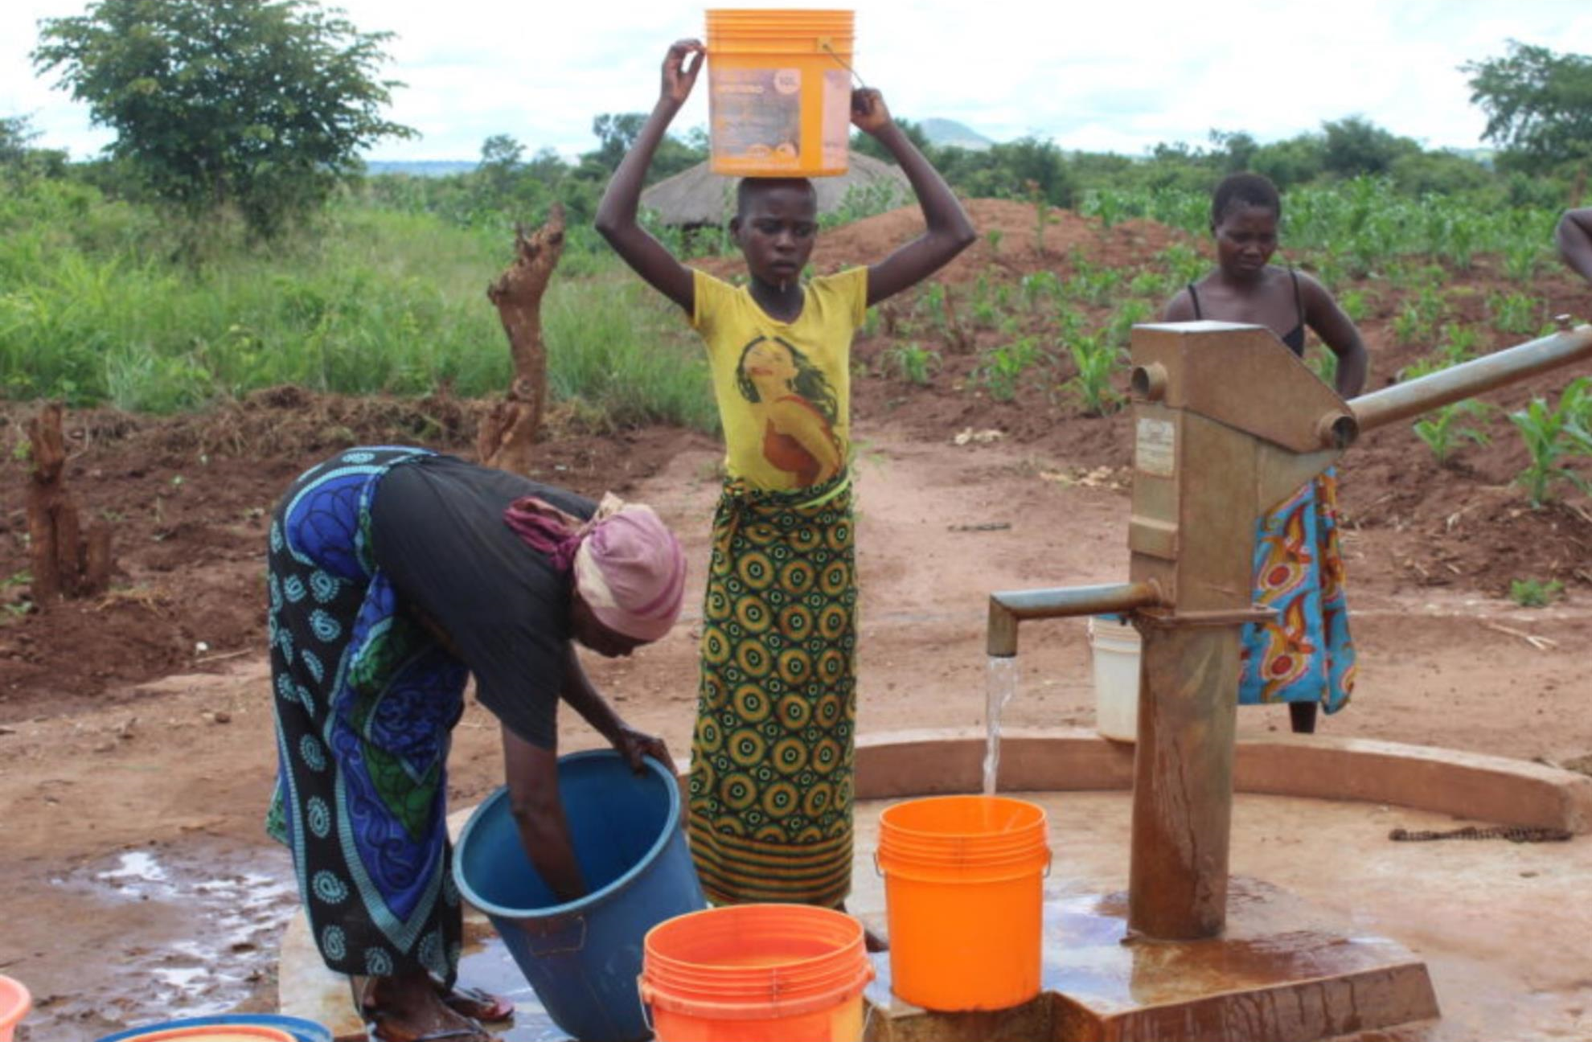
Water project in Haiti
Notes:
A water project in Haiti

Slide 12
Clean Drinking Water
How many people in the world lack drinking water?
1-3 million
3-5 million
5-7 million
Over 7 million
15
Notes:
(POLL: How many people in the world lack drinking water?)

Slide 13
Clean Drinking Water
How many people in the world lack drinking water?
Notes:
(POLL: How many people in the world lack drinking water?)
Answer: 785 million, twice the entire U.S. population
That’s 1 in 9 people in the world and 1/3 of them are under 5 years old

Slide 14
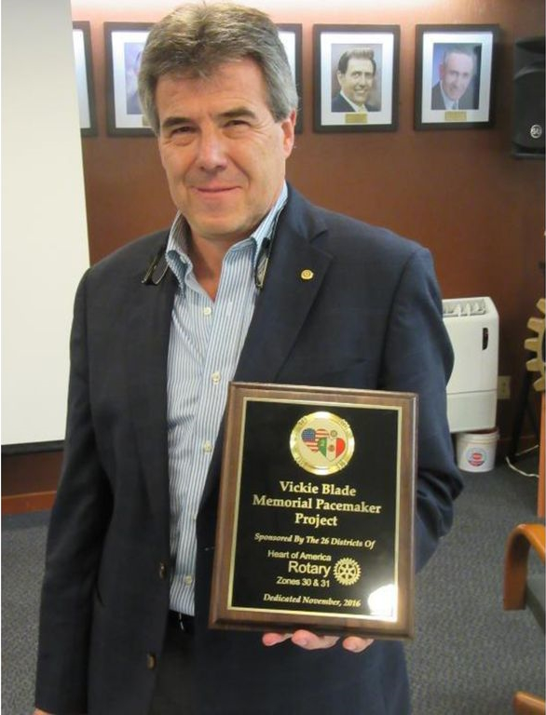
Pacemakers in Mexico
Notes:
Pacemakers in Mexico

Slide 15
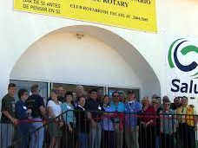
Cleft lip surgeries in Mexico
Notes:
Cleft lip surgeries in Mexico

Slide 16
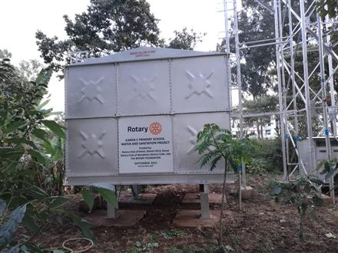
Water & Sanitation in Kenya
Notes:
Water, Sanitation, & Hygiene in Kenya

Slide 17
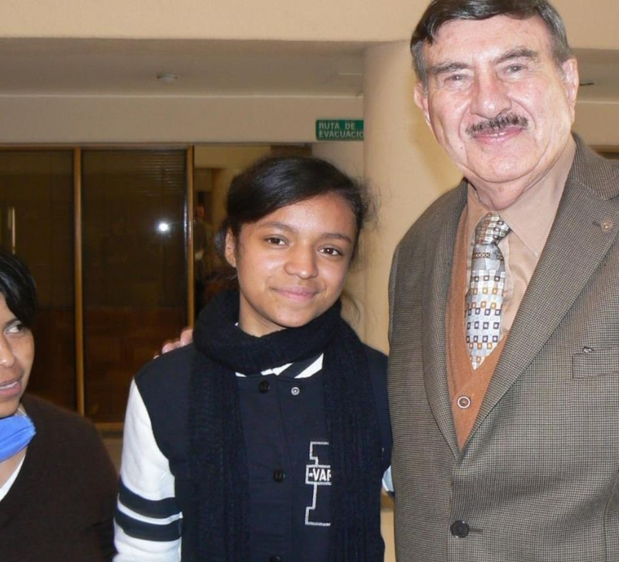
Kidney transplants in Mexico
Notes:
Kidney transplants in Mexico

Slide 18
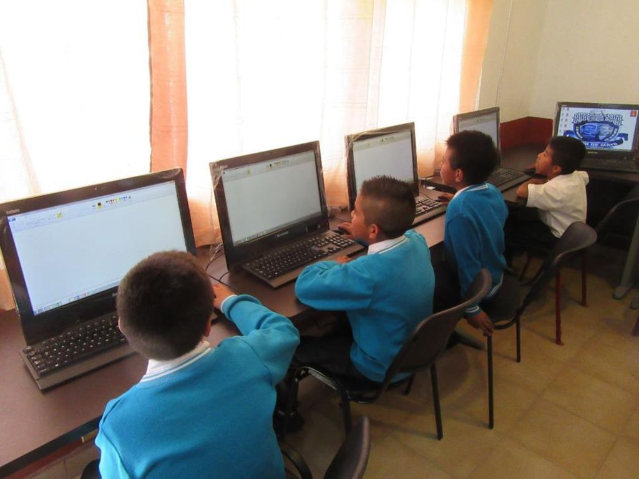
Digital classroom in Panama
Notes:
A digital classroom in Panama

Slide 19
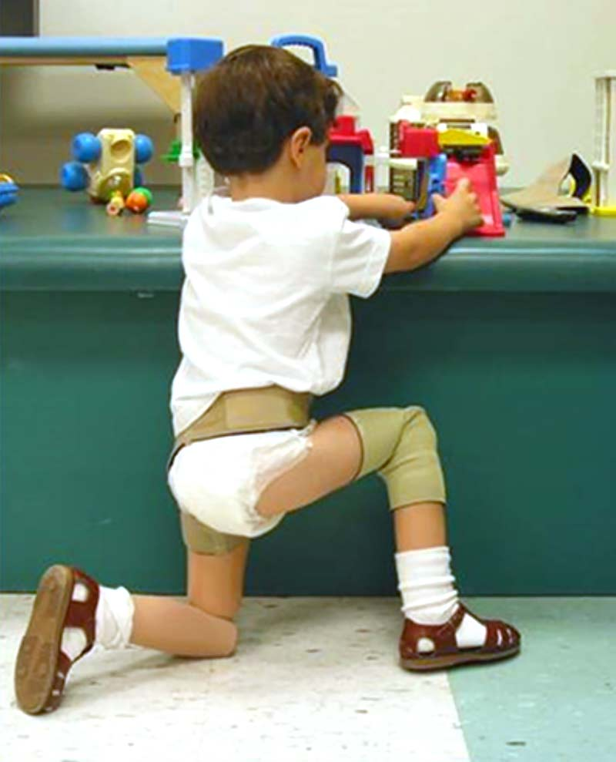
Knee prosthetics in Mexico
Notes:
Knee prosthetics in Mexico

Slide 20
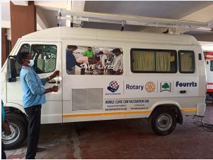
Ambulance in India
Notes:
An ambulance in India
We take some things for granted
India has 28 states, 10 of them have no ambulance service to call, mostly in rural areas

Slide 21
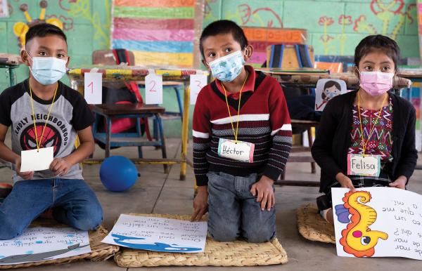
Literacy in Mexico
Notes:
Childhood literacy in Mexico

Slide 22
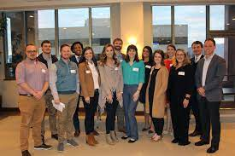
Rotaract peace training in Tennessee
Notes:
Peace training for Rotaractors in Tennessee

Slide 23
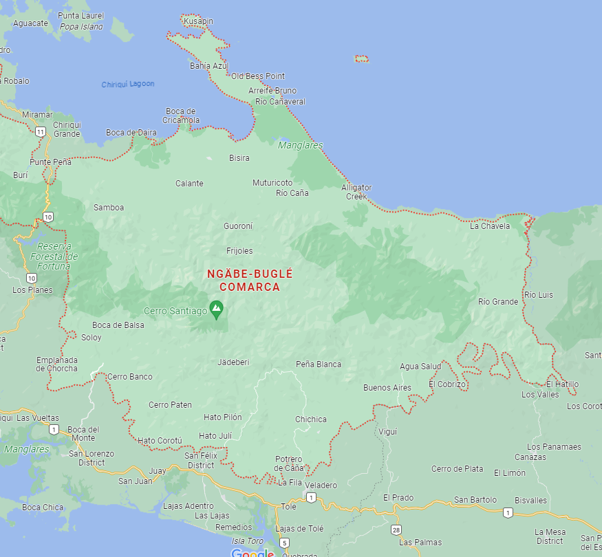
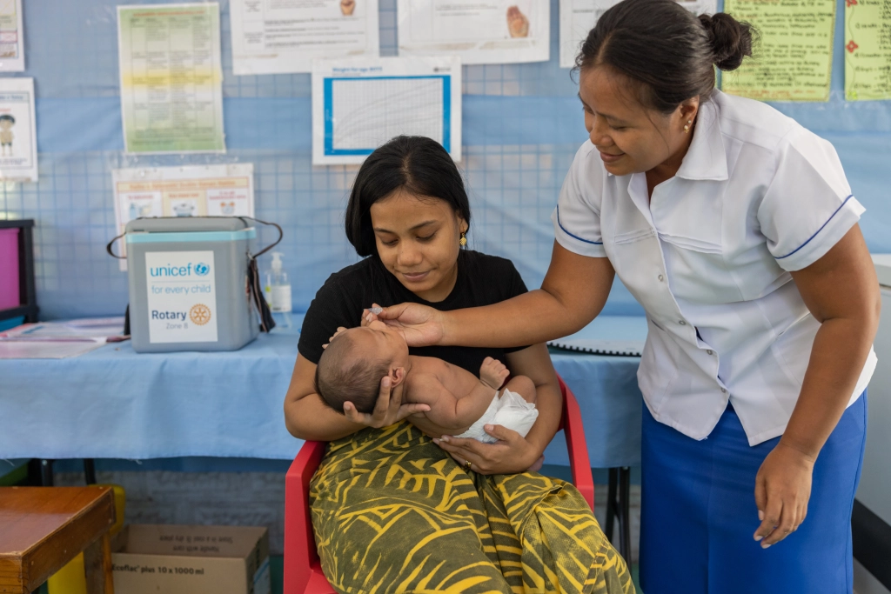
Midwife training in Panama
Notes:
Training for Panamanian midwives

Slide 24
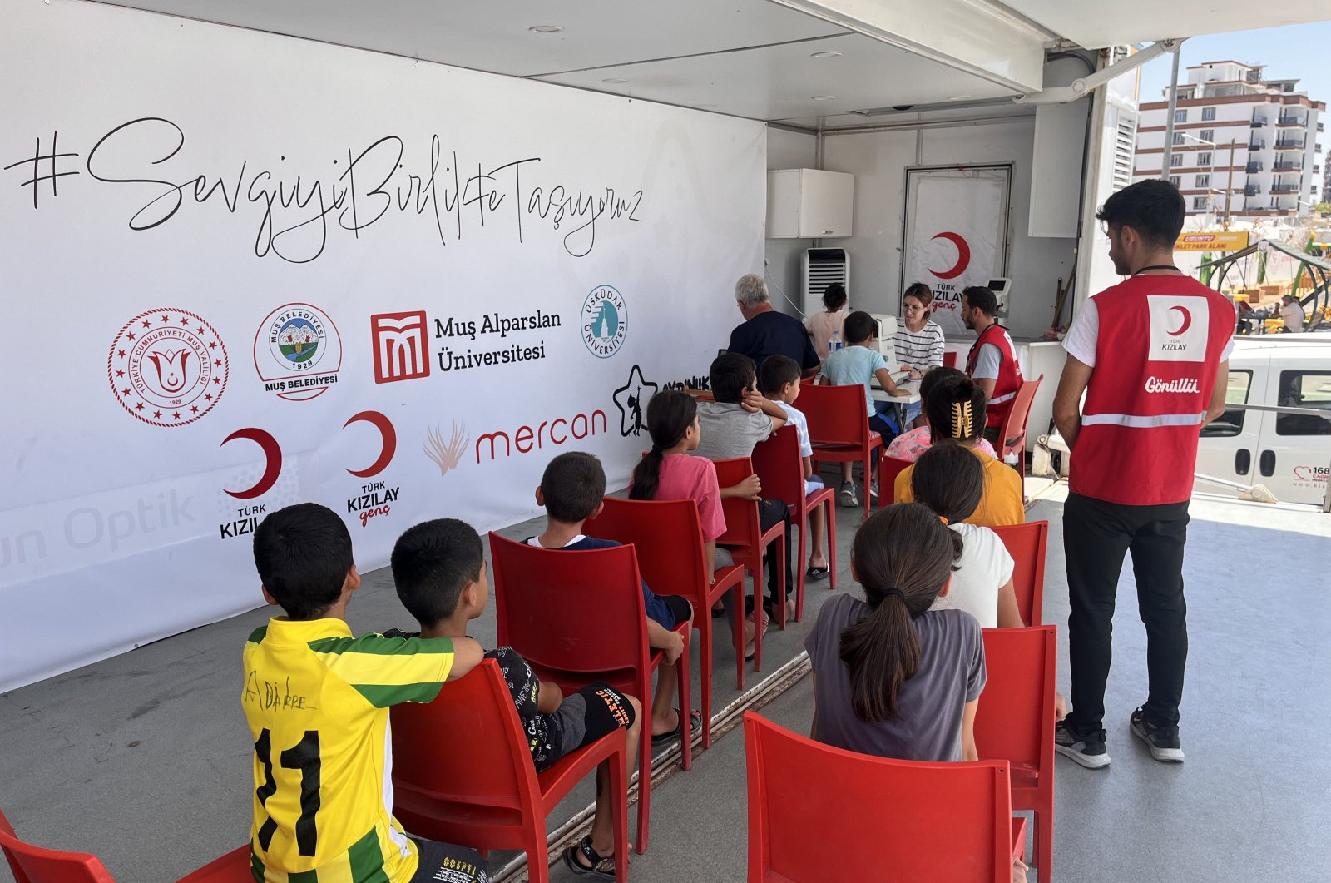
Child vision testing in Turkey
Notes:
Vision testing for Turkey’s children

Slide 25
Recent Projects
Are these projects good uses of your donations?
Yes, I’m glad my donations helped fund them
Yes, I haven’t donated in the past, but might start now
No, foreign communities don’t need Rotary’s help
15
Notes:
(POLL: Did you see any projects that strike you as good uses of your donations to The Rotary Foundation?)

Slide 26
Current Projects
Are these projects good uses of your donations?

Slide 27
Global Grants In Progress
Notes:
And these are similar Global Grants just getting started.
Over $660,000 in total projects.
Could you alone afford to do that much humanitarian work?
Could your club?
Neither could our entire District.
But, in cooperation with other Rotary clubs and districts around the world, you can be part of projects such as these: (click)

Slide 28
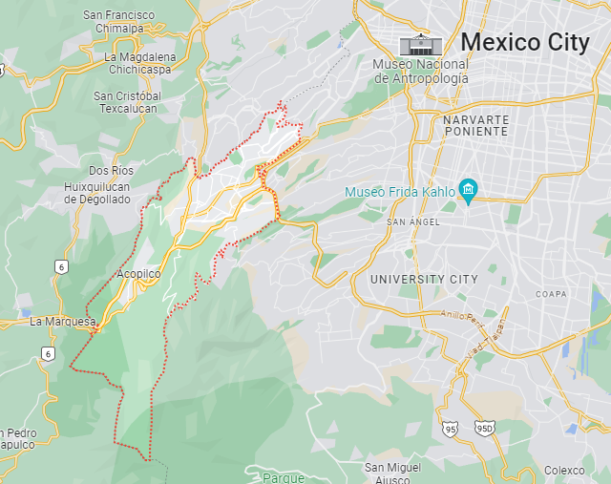
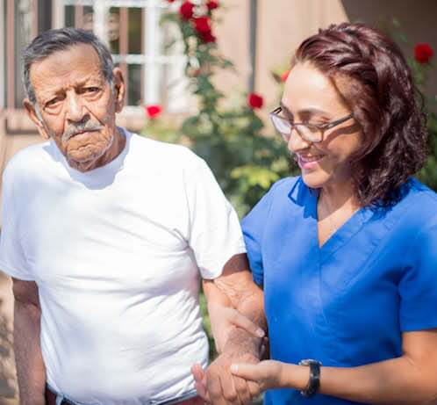
Independent living training in Mexico
Notes:
$36,600 to help train caregivers for senior citizens to help them live independently

Slide 29
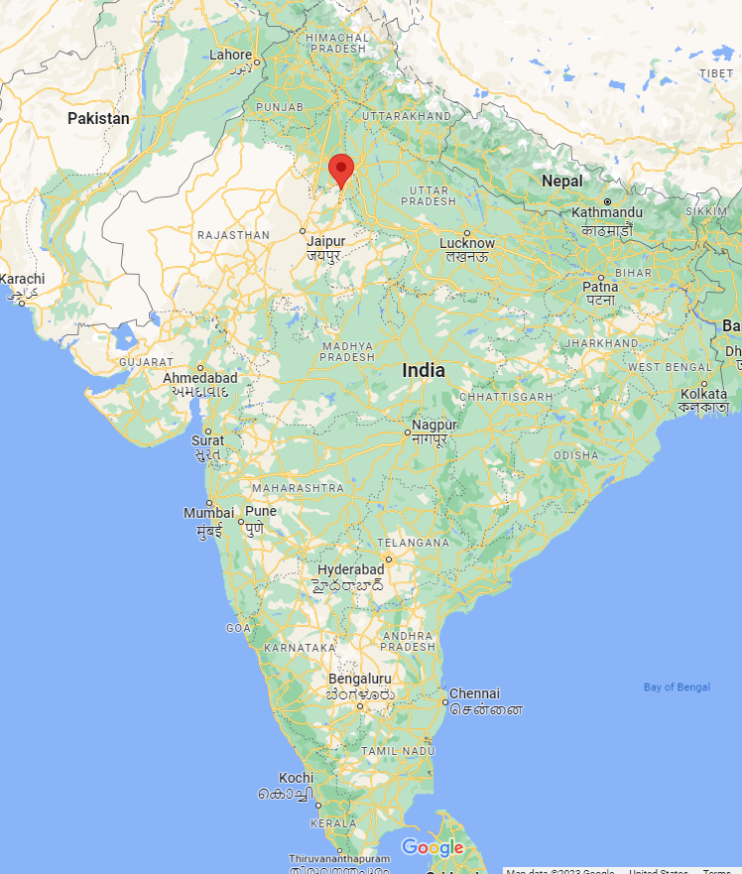
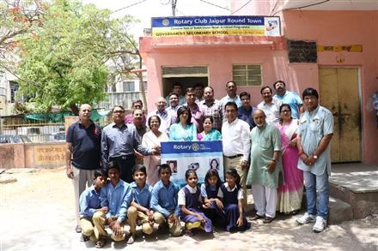
Separate toilets for girls in India
Notes:
$229,000 to build separate restroom facilities for girls in India.
A 2020 survey of 2,000 co-educational government schools found that 40% had no, or unusable toilets.
About 72% had no running water.
25% have no separate toilets for girls.
Almost 23% of girls drop out of school on reaching puberty, which undermines their potential as individuals and future workers

Slide 30
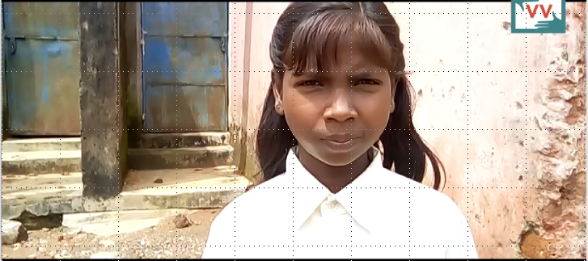
https://www.youtube.com/watch?v=2w6kL_2ZEUk
Notes:
(Video runs 1 minute, 43 seconds)
(Video is at:
This is from India, you’ll need to read the subtitles.

Slide 31
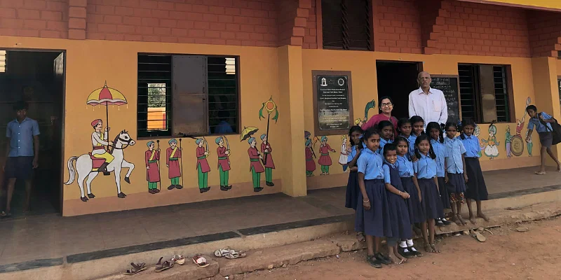
Primary school construction in India
Notes:
$66,000 to build a primary school in India

Slide 32

Two Masters of Public Service scholarships
Notes:
Two, $45,000 scholarships to produce qualified public servants

Slide 33

Dual degree scholarship in International Governance & Diplomacy and Economic Development
Notes:
$86,000 scholarship

Slide 34

Post-graduate scholarship in England (Bella St. Amant)
Notes:
(Let Donna cover this and the next two slides)
A $35,000 scholarship proposed by the Baton Rouge club

Slide 35
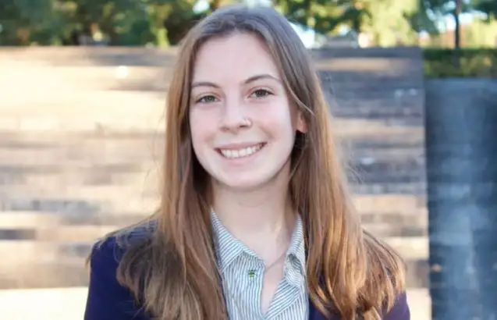
Post-graduate scholarship in Netherlands (Aine O'Nuanain)
Notes:
Another $35,000 scholarship
(A few words about Aine’s arrival in Delft, what she’s studying, and the timeline for our next two scholars’ selection)

Slide 36
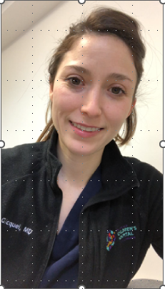
Global Grant Alumnus
Dr. Chantal SanMiguel
Notes:
Here’s just one example of how your donation can completely change lives
(Video runs 2.5 minutes)

Slide 37
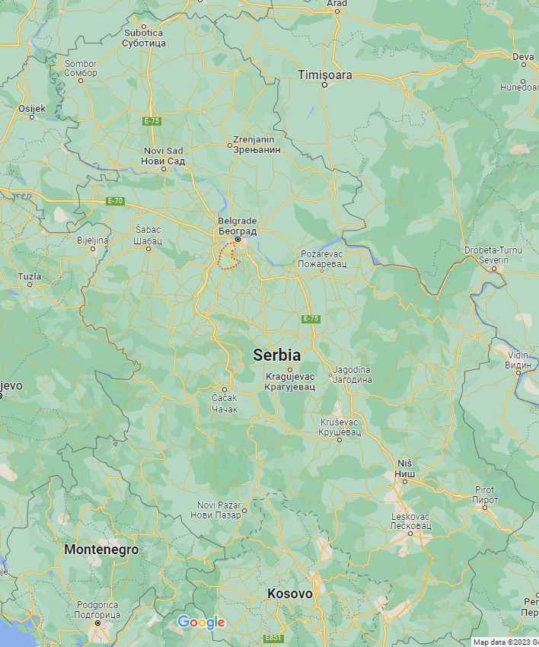
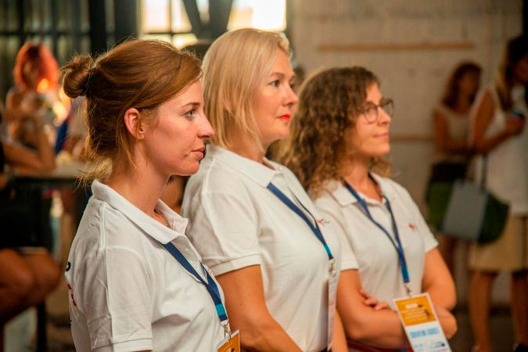
Women entrepreneurship and empowerment in Serbia
Notes:
We got word last week that the $86,000 in funding for this project was just released by the Trustees

Slide 38
Current Projects
Are these projects good uses of your donations?
Yes, I’m glad my donations helped fund them
Yes, I haven’t donated in the past, but might start now
No, Rotary should only fund local projects in our District
15
Notes:
(POLL: Did you see any projects that strike you as good uses of your donations to The Rotary Foundation?)

Slide 39
Current Projects
Are these projects good uses of your donations?

Slide 40
Grants Pending Approval
Notes:
We have committed to help these three additional projects, currently pending approval by the Trustees

Slide 41
Two additional Masters of Public Service scholarships
Notes:
These will be $50,000 each. One for a student coming from Albania and the other from Nigeria.
What do you think they will tell people about Rotary and America when they return to their home countries?

Slide 42
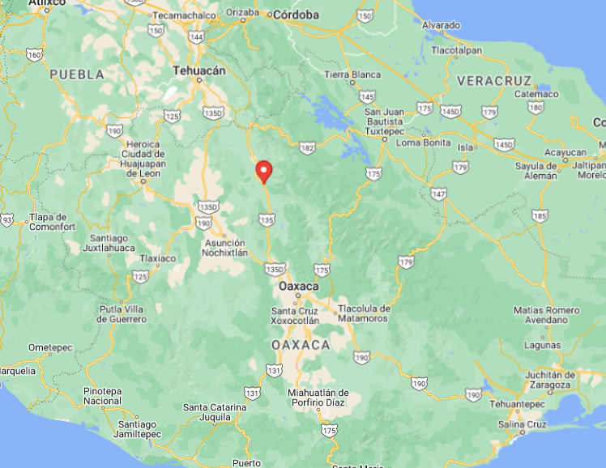
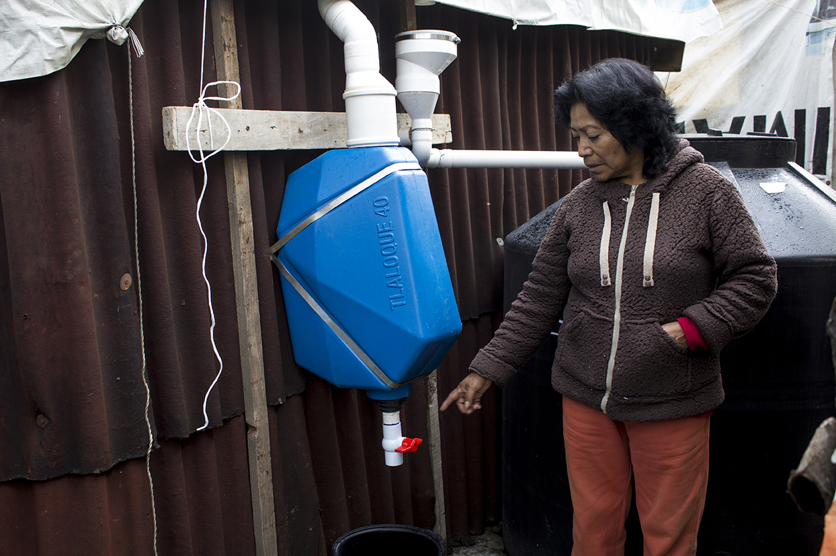
Rainwater harvesting in Mexico
Notes:
A rainwater harvesting project in Mexico, costing $165,000

Slide 43
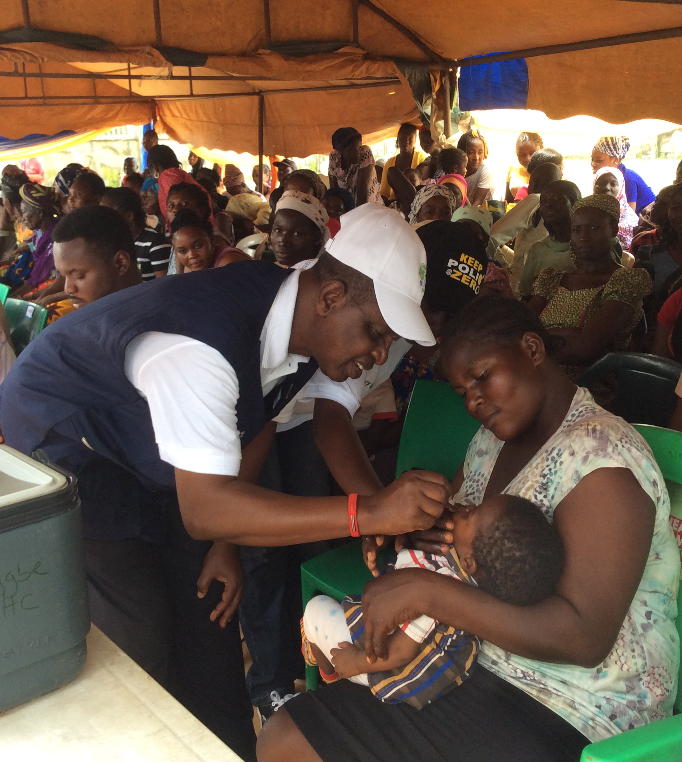
Family Health Days in Nigeria
Notes:
$298,500 for comprehensive health screenings, immunizations, and treatment in Nigeria

Slide 44
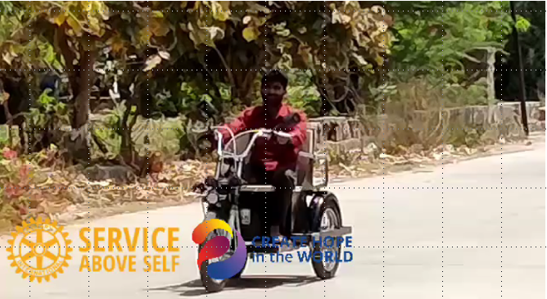
Mobility Tricycles in India
Notes:
And Just last week, I received a request that we partner in this project in India. Total project cost will be $1,830,000

Slide 45
Pending Projects
Should we contribute $2,000-$3,000 to this Project?
Let’s partner with District 3241 in India on this
Let’s contribute more than that
I have a better large global project
No, we shouldn’t help other parts of the world
15
Notes:
(POLL: What do you think?)
We still have about $65,000 in funding we can use for Global Grants this year.
Is it worth investing $2,000-$3,000 of our funding in this tricycle project?

Slide 46
Pending Projects
Should we contribute $2,000-$3,000 to this Project?

Slide 47
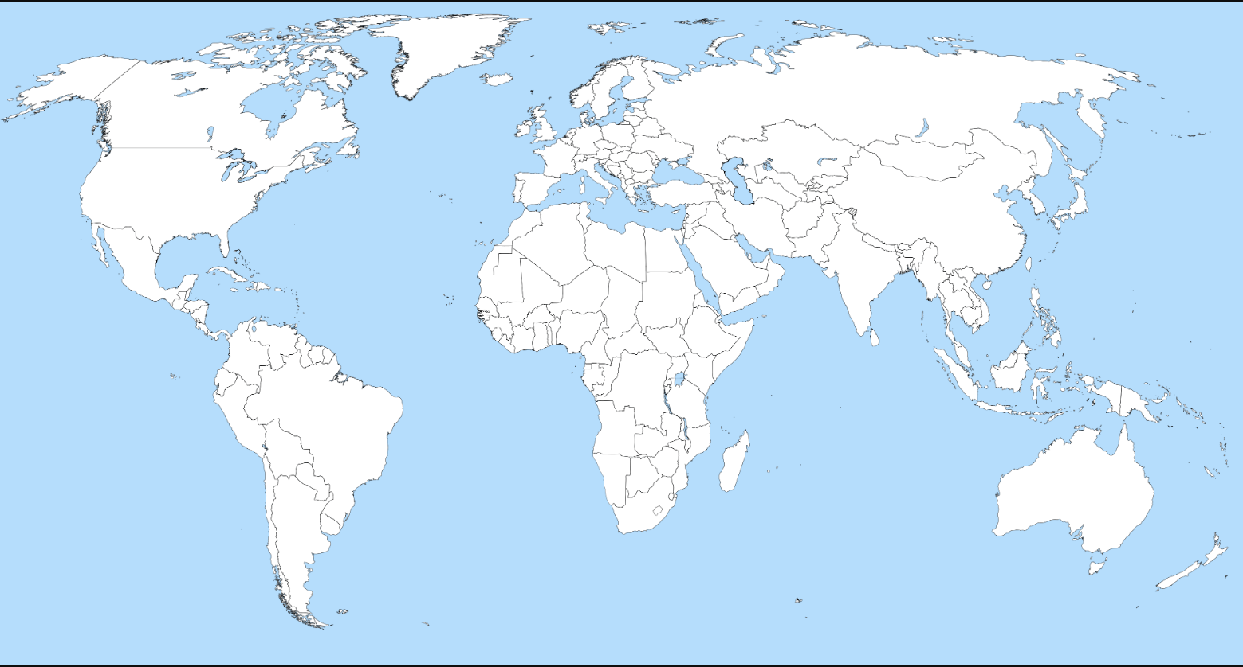


Rotary truly is INTERNATIONAL
Notes:
These are the places where your donations are currently creating hope in the world through Global Grants

Slide 48
QUESTIONS?
Notes:
What questions about Global Grants can I try to answer for you?

Slide 49


